Slide 1
The Public Reallocation of Resources across Age: A Comparison of European NTA countries
European NTA Meeting Stockholm, November 8th-9th 2012
Bernhard Hammer, Michael Freiberger, Alexia Prskawetz
Institute of Mathematical Methods in Economics, Vienna University of Technology
Vienna Institute of Demography, Austrian Academy of Sciences
Wittgenstein Centre for Demography and Global Human Capital

Slide 2
Structure of the talk
1. Introduction
2. Cumulative distribution of transfers
3. Lee arrows
Institute for Mathematical Methods in Economics
Economics

Slide 3
1. Introduction
Re-allocation of resources across age
Plot cumulative distribution of transfers by age:
above diagonal – transfers biased towards young age
below diagonal – transfers biased towards old age
Use the concept of Lee arrows and advanced Lee arrows
Countries we consider:
Austria, Finland, France, Germany, Hungary, Italy, Slovenia,
Spain, Sweden, UK
Institute for Mathematical Methods in Economics
Economics

Slide 4
1. Introduction
Cumulative age distribution of NTA-countries
9 - 11
16 - 21
25 - 30
31 - 37
38 - 43
45 - 49
52 - 57
61 - 65
71 - 75
Institute for Mathematical Methods in Economics
Economics

Slide 5
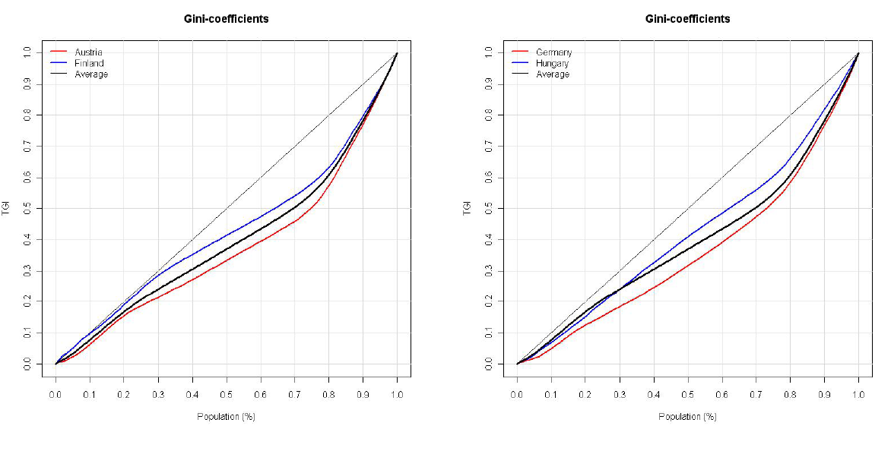
2. Cumulative distribution of transfers
1. total public transfers - INFLOWS
Institute for Mathematical Methods in Economics
Economics

Slide 6
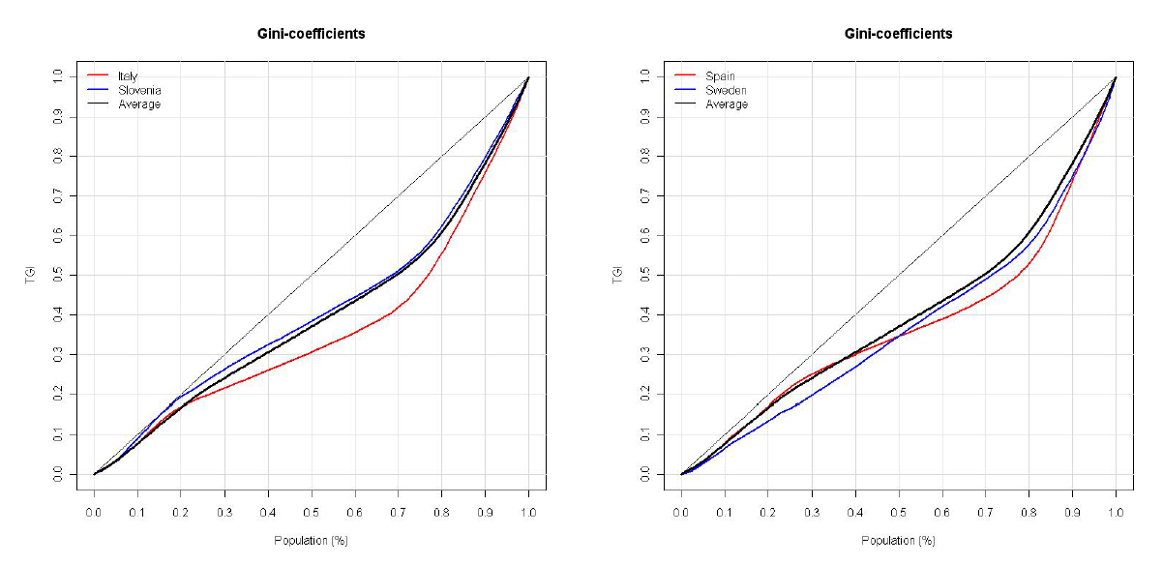
2. Cumulative distribution of transfers
Institute for Mathematical Methods in Economics
Economics

Slide 7
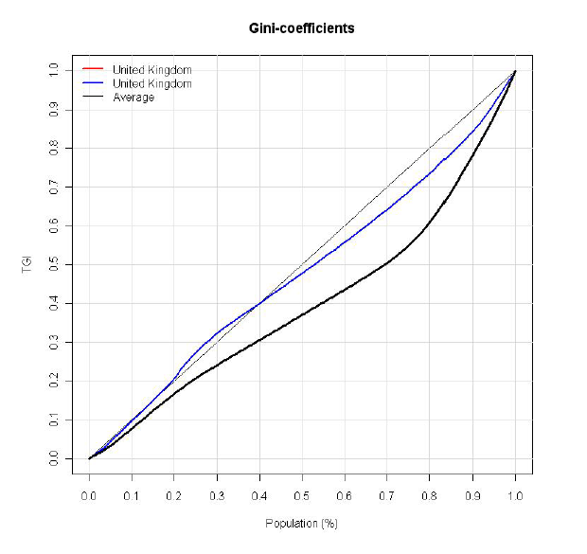
2. Cumulative distribution of transfers
3 groups:
UK – near diagonal
Austria, Germany, Sweden, Spain
Finland, Slovenia, Hungary
In all cases below diagonal:
Old age oriented transfer systems
Institute for Mathematical Methods in Economics
Economics

Slide 8
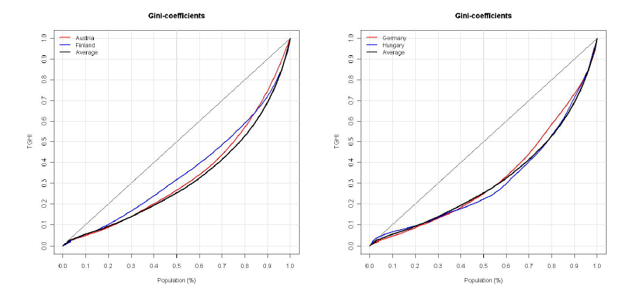
2. Cumulative distribution of transfers
2. Health transfers
Institute for Mathematical Methods in Economics
Economics

Slide 9
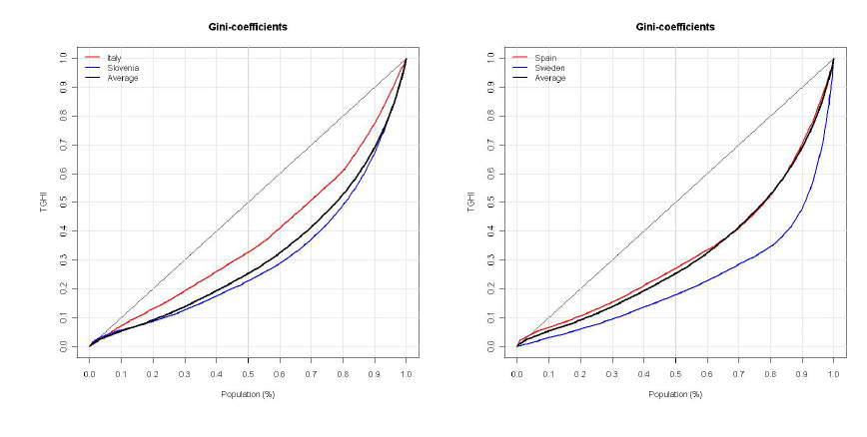
2. Cumulative distribution of transfers
Institute for Mathematical Methods in Economics
Economics

Slide 10
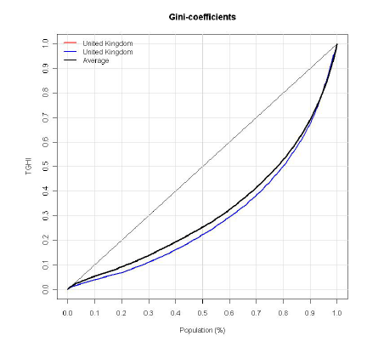
2. Cumulative distribution of transfers
3 groups:
Italy – less targeted towards elderly
Sweden – highly targeted towards elderly
Austria, Finland, Germany, Hungary,
Slovenia, Spain, UK
In all cases below diagonal:
Old age oriented health transfer
Institute for Mathematical Methods in Economics
Economics

Slide 11
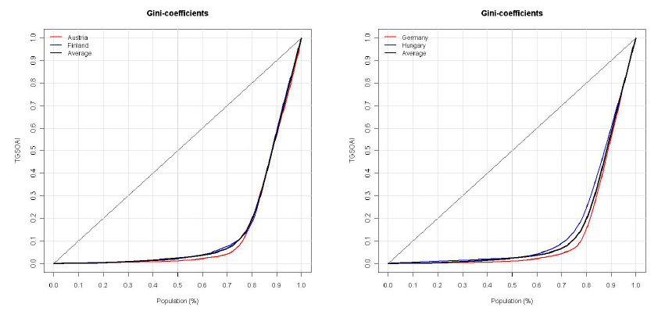
2. Cumulative distribution of transfers
3. Pension transfer
Institute for Mathematical Methods in Economics
Economics

Slide 12
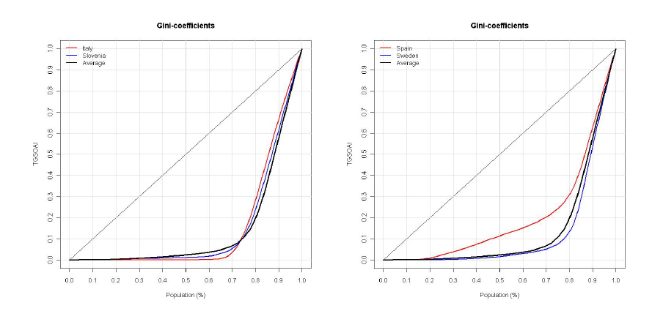
2. Cumulative distribution of transfers
Institute for Mathematical Methods in Economics
Economics

Slide 13
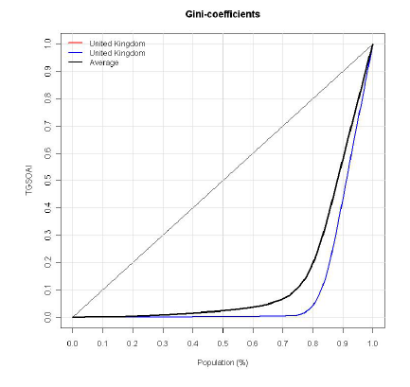
2. Cumulative distribution of transfers
3 groups:
Spain – very early
UK – verly late
Austria, Finland, Germany, Hungary,
Italy, Slovenia, Sweden
Institute for Mathematical Methods in Economics
Economics

Slide 14
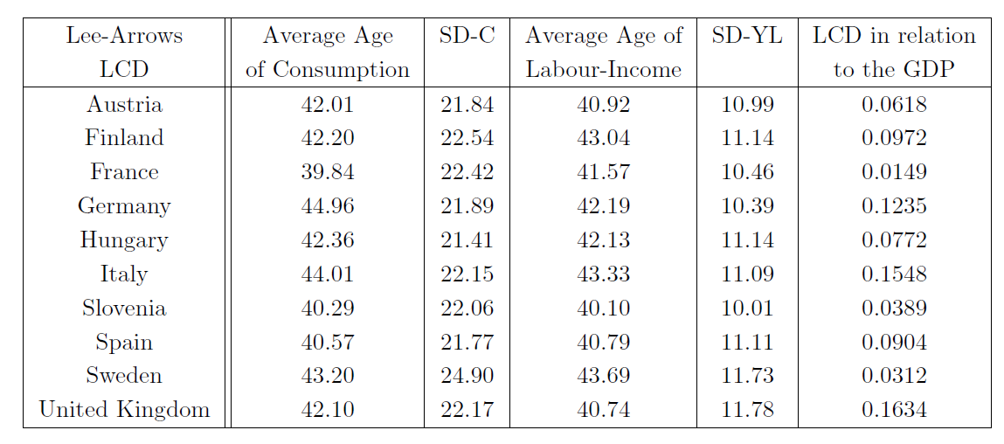
3. Lee arrows
Lee-Arrows for LCD
40 – 45 40 - 44
Institute for Mathematical Methods in Economics
Economics

Slide 15
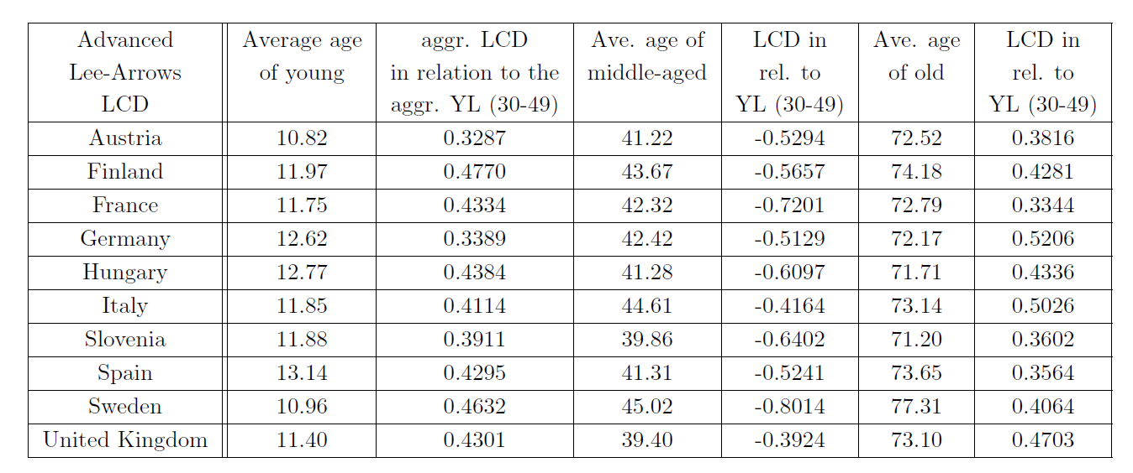
3. Lee arrows
Advanced Lee-Arrows for LCD
Institute for Mathematical Methods in Economics
Economics

Slide 16
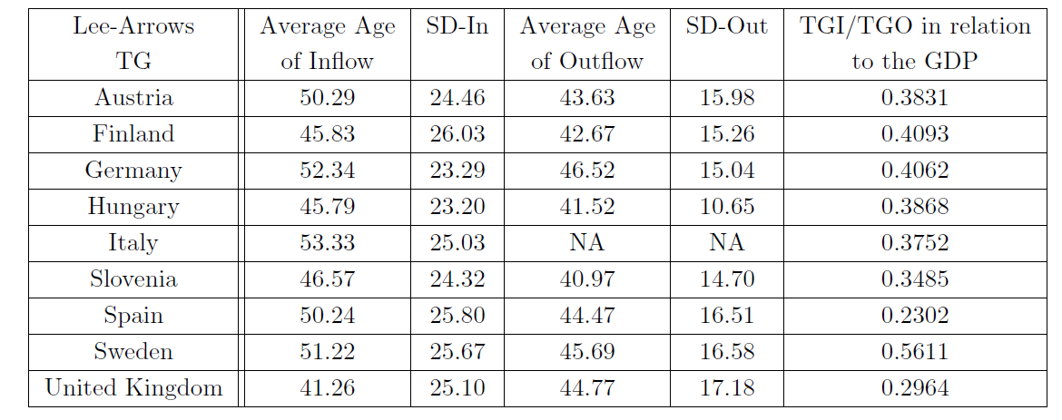
3. Lee arrows
Lee-Arrows for Public Transfers
Institute for Mathematical Methods in Economics
Economics

Slide 17
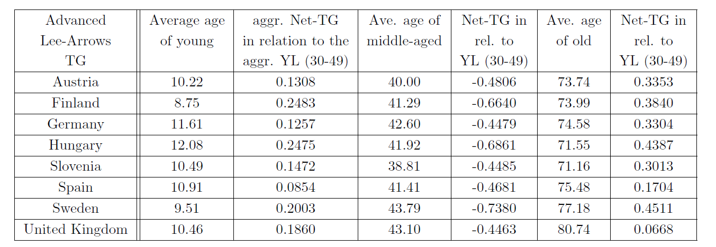
3. Lee arrows
Advanced Lee-Arrows for Public Transfers
Institute for Mathematical Methods in Economics
Economics

Slide 18
4. Discussion
Institute for Mathematical Methods in Economics
Economics

Slide 19
THANK YOU
Institute for Mathematical Methods in Economics
Economics

